Slide 1




Fake news detection using PassiveAggressiveClassifier
PREETHAM HD

Slide 2
Abstract
Our Day-to day life has always been influenced by what people think. Ideas and opinions of other have always affected out own opinions.
The hazardous development of fake news and its disintegration to vote based system, peddling fake information on social media expanded the interest for fake news detection
Online news platforms enormously impact our daily life and culture in both good and bad ways

Slide 3
Introduction
Online media for news utilization is a blade that cuts both ways
The broad spread of fake news contrarily affects people and society.
Most of our life is spent interacting with people online and share information rather than seeking information from traditional news platforms“I am so happy today good morning to everyone “ is a general positive text.
To increase readership and attract viewers and collect advertising revenue, some news sources publish fake news and many political parties are spreading fake news and rumors for their party benefits.
we have proposed a method to detect fake news on basis of the news source, author, and organization, to identify the fake news we have used some machine learning algorithms to label the news as fake or real.

Slide 4
Objectives of the Study
The primary target is to prepare a model to detect and label fake news articles from various platforms, which is a text classification problem with a straightforward solution. The aim of the model is to predict the news as “fake” or “real”.
Using TFIDFVectorizer and PassiveAggressiveClassifiers for classifying with more accuracy.

Slide 5
Problem Statement
There is no fact-checking in social media post, people are mainly dependent on social media for information and the fake news is posted all around social media it’s getting hard for people to find out which one is true and which one is fake news, fake news will trigger people or some community and it’s hard to maintain peace in the society, the project is concerned with the finding solution to the fake news which has widely spread over the social media.

Slide 6
Proposed Solution
We have proposed a model to detect fake news by using filters and machine learning algorithms to predict the news as real or fake based on the author and news source and organization, we built a model to detect it with more accuracy to help people and prevent social media misleading the people, the model label the news as fake or real based on the model trained which helps the readers to distinguish between real and fake information. most of the news sources are published on the web, so many political parties, some organizations, and publishers spread fake news to their benefits so fake news detection and fact-checking models are necessary.

Slide 7
Material and Methods
TF-IDF
PassiveAggressiveClassifier

Slide 8
Methodology
TF-IDF Vectorizer
TF-IDF is an abbreviation for Term Frequency Inverse Document Frequency. It is a common machine learning algorithm to transform the text into numbers and given for prediction, it is most suitable for large data sets based on the IDF value, the word which is common in between all the data will be given low IDF value, the unique word will be highlighted using the max IDF value, which helps to ignore common words and highlight unique words for building a model.

Slide 9
Passive Aggressive Classifiers
Passive Aggressive Classifier is one of the “online-learning algorithms”, which takes the input in the sequential order and the learning model is updated step by step, this algorithm is most suitable for large data sets, and it is more suitable for social media platforms where data is added every second. The passive means if the prediction is correct the model is not going to change it will remain the same. Aggressive In the sense, if the prediction is wrong it will change the model, it will get a training example and then update the classifier, and then throw away the example.

Slide 10
In the project, the point is to discover the exhibition of the proposed system on fake or real news classifier. The first step was to load the dataset which is collected from kaggle.com which is a large dataset based on US journal news articles that includes article ID, title, and news labels, 80% of the dataset is used as training data, and the remaining 20% is used as testing data, at first the dataset is loaded and split method is used, then that data will be passed to TfidfVectorizer and then our model is trained using Passive Aggressive Classifier and it will predict based on the trained model, the proposed model was able to attain the 93.76% accuracy. In the second step the Flask has to be installed and connected to the model which helps to create GUI for the proposed model.

Slide 11
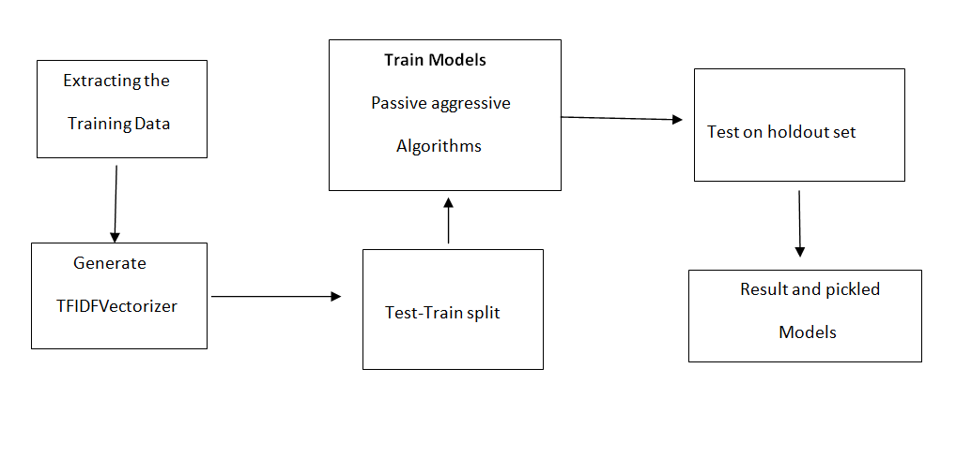
Work Flow Diagram

Slide 12
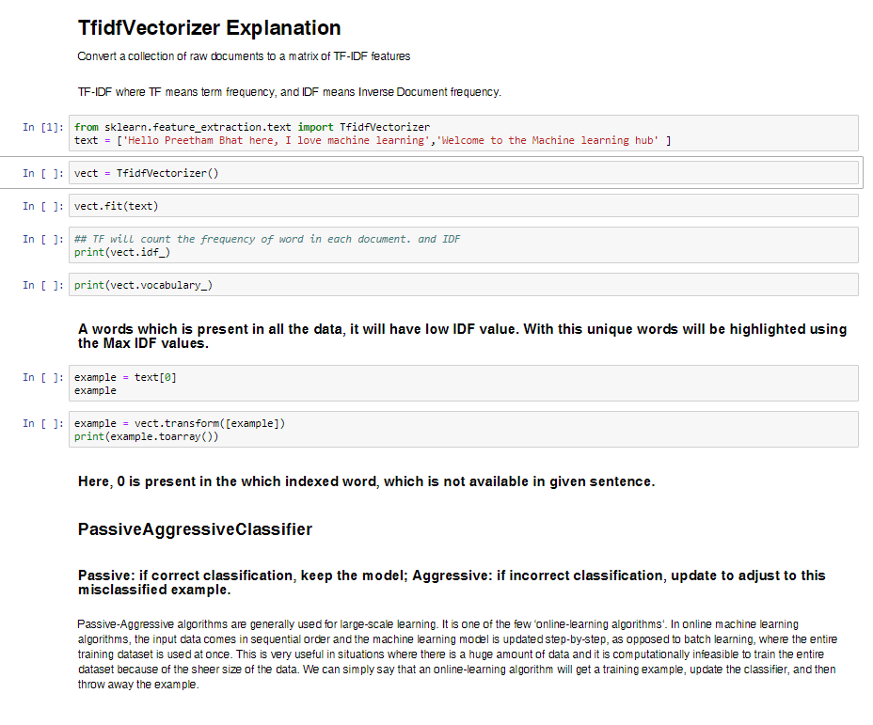
Code : -

Slide 13
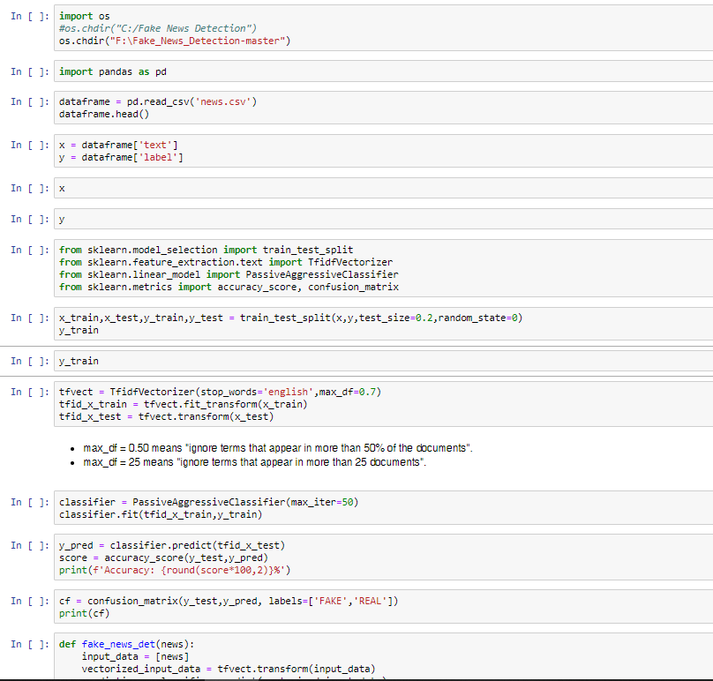
Implementing TF-IDF

Slide 14
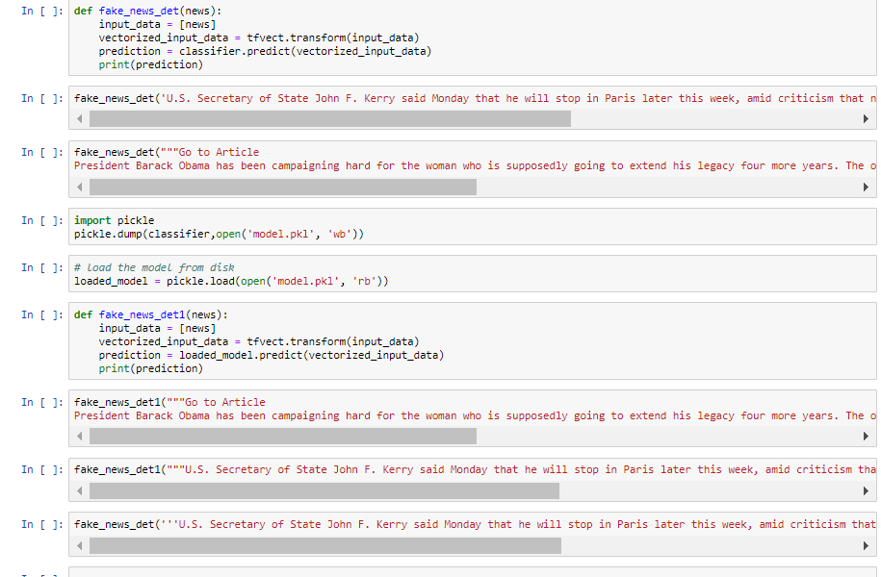
Passing data to classifier :

Slide 15
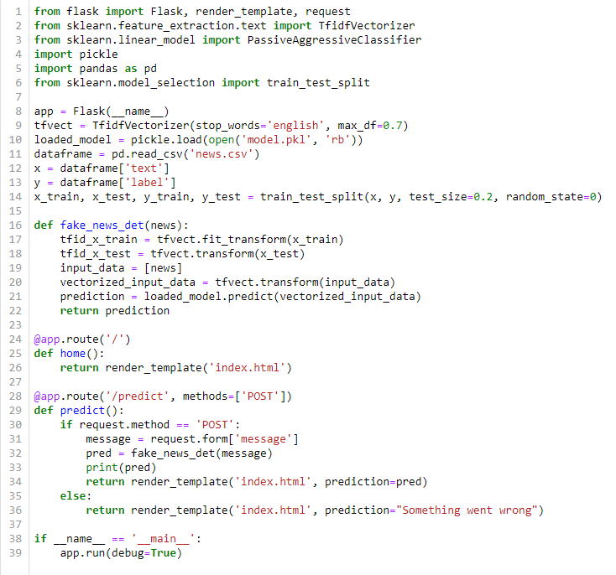
Flask Model :

Slide 16
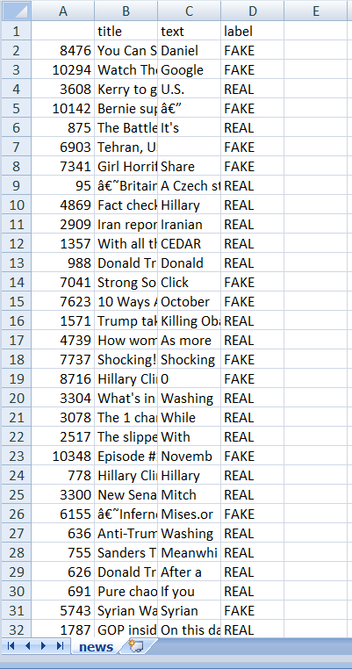
CSV File :

Slide 17
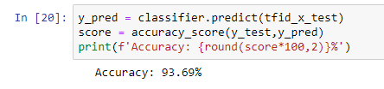
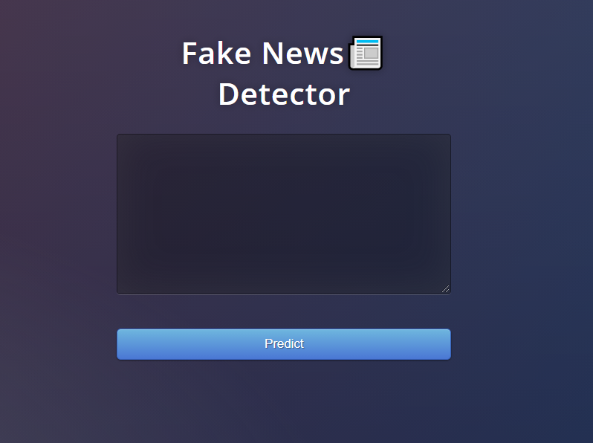
OUTPUT:

Slide 18
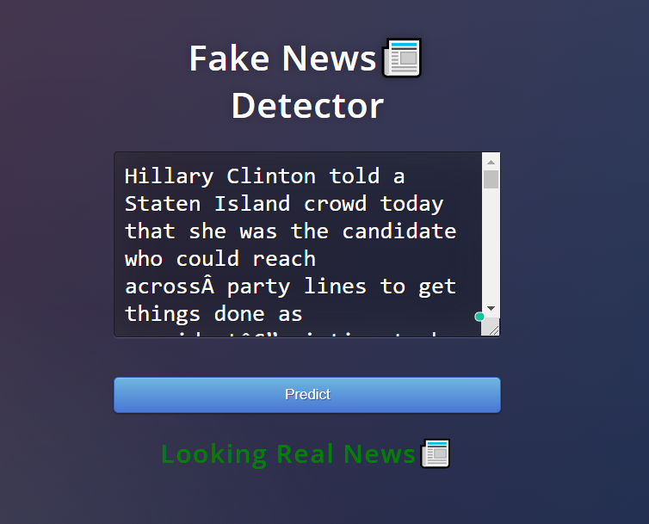
For Real News :

Slide 19
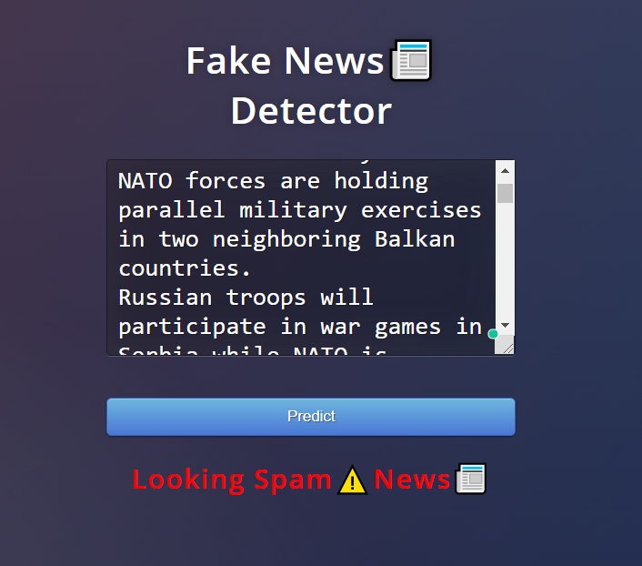
For Fake News :

Slide 20
Conclusion
Social media popularity is increasing day by day with the huge number of users and more people consume news from social media rather than traditional news media, and a huge rate of fake news is spread on social media which causes negative impacts on the users. Political parties, some journals, and news channels spread fake news for their gain. Fake information spreads faster than real news so the impact will be very high on the people following it without knowing the authenticity of the news. So the model was proposed with the help of machine learning algorithms to detect and predict fake news. Fake news spreading is one of the biggest threats to democracy and misleads the people so fact-checking and fake news detecting model is necessary.

Slide 21
List of References :
Kai Shu, Amy Sliva, Suhang Wang, Jiliang Tang, and Huan Liu. 2017. Fake News Detection on Social Media: A Data Mining Perspective. SIGKDD Explor. Newsl. 19, 1 (June 2017), 22–36. DOI:https://doi.org/10.1145/3137597.3137600
Xinyi Zhou, Reza Zafarani, Kai Shu, and Huan Liu. 2019. Fake News: Fundamental Theories, Detection Strategies and Challenges. In Proceedings of the Twelfth ACM International Conference on Web Search and Data Mining (WSDM '19). Association for Computing Machinery, New York, NY, USA, 836–837. DOI:https://doi.org/10.1145/3289600.3291382
J. C. S. Reis, A. Correia, F. Murai, A. Veloso and F. Benevenuto, "Supervised Learning for Fake News Detection," in IEEE Intelligent Systems, vol. 34, no. 2, pp. 76-81, March-April 2019, doi: 10.1109/MIS.2019.2899143.
A. Uppal, V. Sachdeva and S. Sharma, "Fake news detection using discourse segment structure analysis," 2020 10th International Conference on Cloud Computing, Data Science & Engineering (Confluence), Noida, India, 2020, pp. 751-756, doi: 10.1109/Confluence47617.2020.9058106.
S. I. Manzoor, J. Singla and Nikita, "Fake News Detection Using Machine Learning approaches: A systematic Review," 2019 3rd International Conference on Trends in Electronics and Informatics (ICOEI), Tirunelveli, India, 2019, pp. 230-234, doi: 10.1109/ICOEI.2019.8862770.
Meital Balmas. When fake news becomes real: Combined exposure to multiple news sources and politica attitudes of ine_cacy, alienation, and cynicism. Communication Research, 41(3):430-454, 2014
Michele Banko, Michael J Cafarella, Stephen Soderland, Matthew Broadhead, and Oren Etzioni. Open information extraction from the web. In IJCAI'07.

Slide 22
Thank You

